Slide 1
LAB – 09
Friend function and classes, virtual inheritance

Slide 2
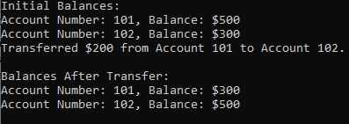
Task - 1
Write a C++ program to implement a class BankAccount with private data members like balance and accountNumber. Define a friend function transferFunds() that allows transferring money between two BankAccount objects. The friend function should access the private members of both accounts to perform the transfer operation.

Slide 3
Task - 2
Design a C++ program that defines a Rectangle class with private members length and width. Write a friend function calculateArea() that computes the area of a rectangle. The function should be able to access the private members of the Rectangle object to perform the area calculation.

Slide 4
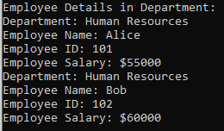
Task - 3
Write a C++ program that defines two classes: Employee and Department. The Employee class contains private details such as name, id, and salary. The Department class should be a friend of Employee, allowing it to access the private data of Employee objects. Implement a method in the Department class to display details of all employees working in a specific department.

Slide 5
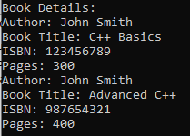
Task - 4
Create a C++ program that defines two classes: Book and Author. The Book class has private members like title, isbn, and pages. The Author class has a private member name. The Author class should be a friend of the Book class, allowing it to access the private data of the Book class. Implement a function in the Author class to print the details of all books written by the author.

Slide 6

Task - 5
Design a base class Vehicle with attributes make and model, and a function showDetails(). Use virtual inheritance to derive Car and Truck classes, each adding attributes (numDoors for Car and loadCapacity for Truck) and overriding showDetails(). Create a PickupTruck class that inherits from both Car and Truck, ensuring it properly manages attributes and functions of the Vehicle base class.

Slide 7

Task - 6
Implement a Device class with attributes brand and model, and a method powerOn(). Derive Smartphone and Laptop classes using virtual inheritance, each adding specific attributes (hasTouchscreen for Laptop and batteryLife for Smartphone). Create a HybridDevice class that inherits from both Smartphone and Laptop, overriding the powerOn() method to demonstrate its hybrid functionality.

Slide 8
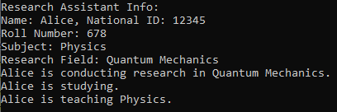
Task – 7
Build a base class Person with attributes name and nationalID, and a method displayInfo(). Virtually inherit it in Student and Teacher classes. Add attributes like rollNumber for Student and subject for Teacher, each with their respective functions (study() and teach()). Create a ResearchAssistant class inheriting from both Student and Teacher, adding its own attribute researchField and function conductResearch().

